Slide 1
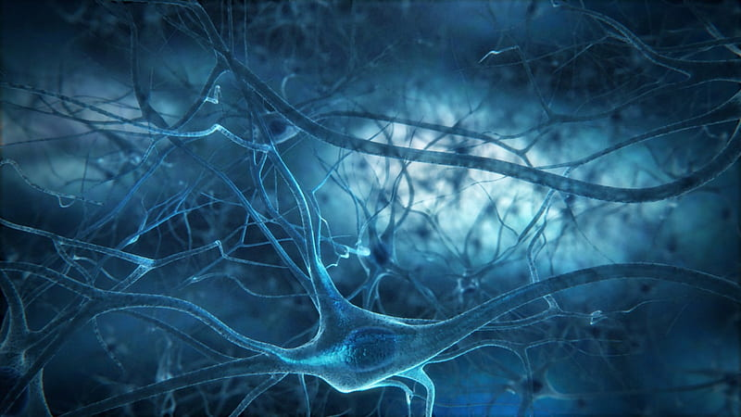
Activation Functions and Comparisons of Trends in Practice
ManiKanta Rajoli

Slide 2

Agenda
Motivation For Activation Functions.
Laws of Activation Function
Need for Complex Activation Function
Popular Activation Function
Implementation
Comparisons
Conclusion

Slide 3
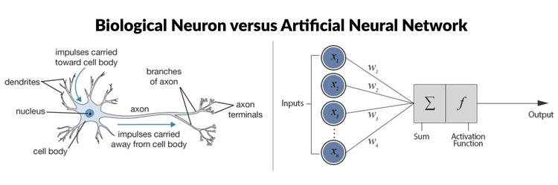
Motivation for Activation Functions
30
23

Slide 4
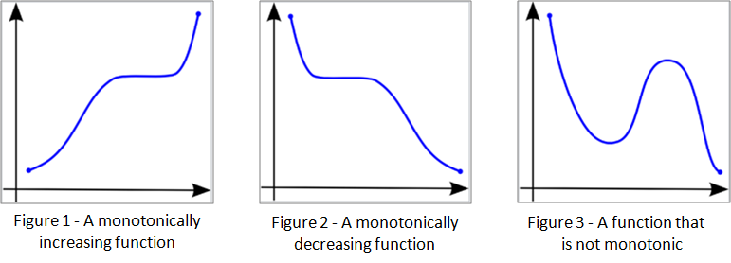
Laws of Activation Function:
Monotonic : A function is said to monotonically increasing if x increase it’s corresponding y increases
Continues : A continuous curve without any gap
Easily differentiable: it should be smooth ‘continues’ curve and differentiable at every point

Slide 5
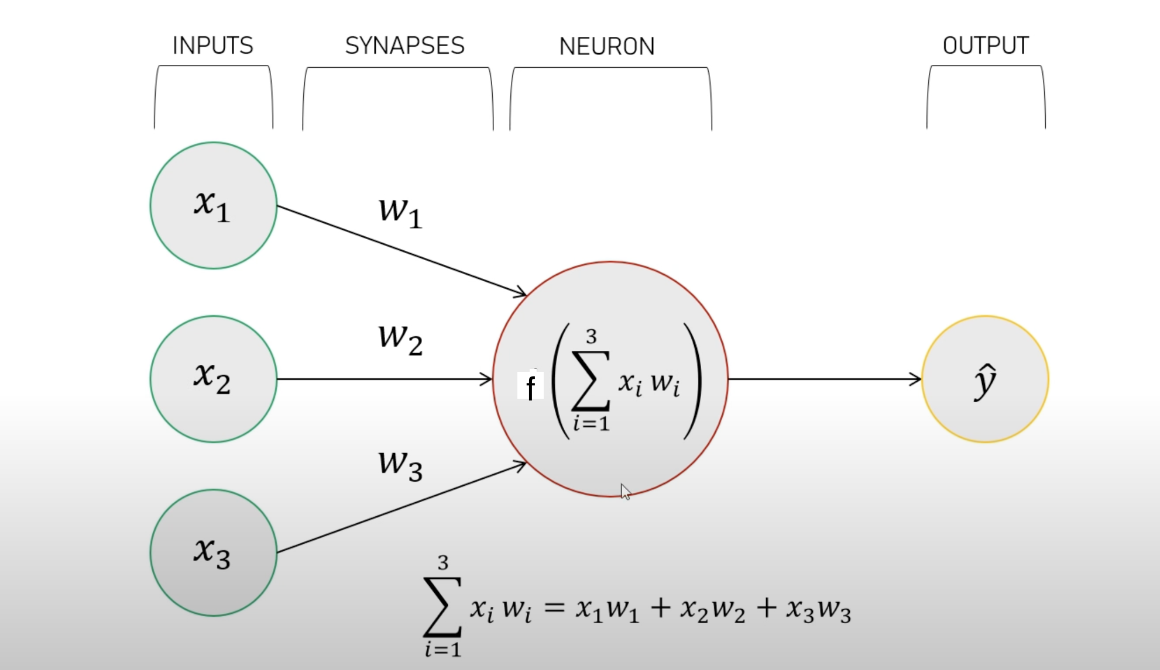
Need for Complex Activation Functions
Perceptron
1 if (w^{T}x + b) > 0
f(x) =
0 other wise
Problem : Diffculty of Understanding the complex patterns in the data (Linearity)
Complex patterns such as
Images, audio, speech etc..,

Slide 6
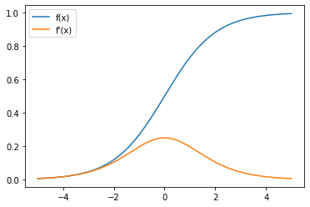
Popular Activation Functions
Sigmoid :
f(x) = (0,1)
f’(x) = (0,0.25)
f(x) (or) 𝞂(x) = 1 / 1 + e^{-x}
f’(x) (or) 𝞂’(x) = 𝞂(x) * (1- 𝞂(x))
.
30
23

Slide 7
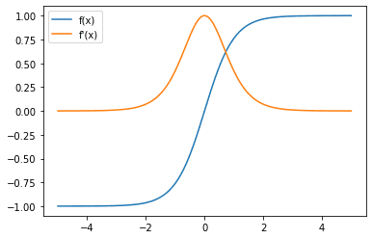
Popular Activation Functions
Tanh:
f(x) = (-1,1)
f’(x) = (0,1)
tanh(z) = e^{z} – e^{-z} / e^{z} + e^{-z}
d(tanh)
---------- = 1 - tanh(z)²
dz
.
30
23

Slide 8
Problem : Vanishing Gradient → Biggest problem of neural network𝜕
f₁₁
X _{i1}
w^{i}₁₁
o₁₁
f₂₁
o₁₁
o₂₁
f₁₂
o₃₁
X _{i2}
f₃₁
y_{i}^
o₂₂
X _{i3}
f₂₂
Layer 3
f₁₃
X _{i4}
Layer 2
Layer 1
𝜕o₃₁
------ *
𝜕o₂₂
𝜕o₂₂
------ *
𝜕o₁₁
𝜕o₁₁
------
𝜕w¹₁₁
𝜕o₃₁
------ *
𝜕o₂₁
𝜕o₂₁
------ *
𝜕o₁₁
𝜕o₁₁
------ *
𝜕w¹₁₁
𝜕L
------ =
𝜕w¹₁₁
+

Slide 9
No.of multiplication of derivative
=
No.of hidden layers + 1
Vanishing Gradient
As derivatives becoms small
Chain rule & Multiplication
These values are between 0& 1
Because we are using Sigmoid & tanh
This reason people could not train 5, 10, 15 layers

Slide 10
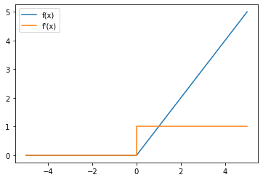
The Solution - Relu
0 if x <=0
Relu:
f(x) =
x otherwise
.
f’(x) =
At 0 will not differentiate
30
23
1 otherwise
dying relu

Slide 11
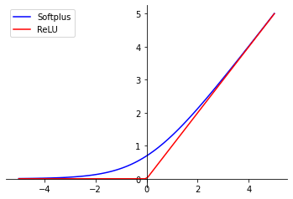
Approximation technique - softplus
Relu:
f(x) = log( 1 + e^{x} )
f’(x) = e^{x} / (1 + e^{x})
Smooth
approximation
.

Slide 12
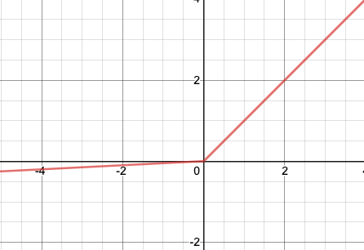
Fix for dying Relu – Leaky Relu
x if x > 0
Leaky Relu:
f(x) =
0.01x otherwise
Leaky
Relu
.
f’(x) =
1 if x > 0
30
23
0.01 otherwise

Slide 13
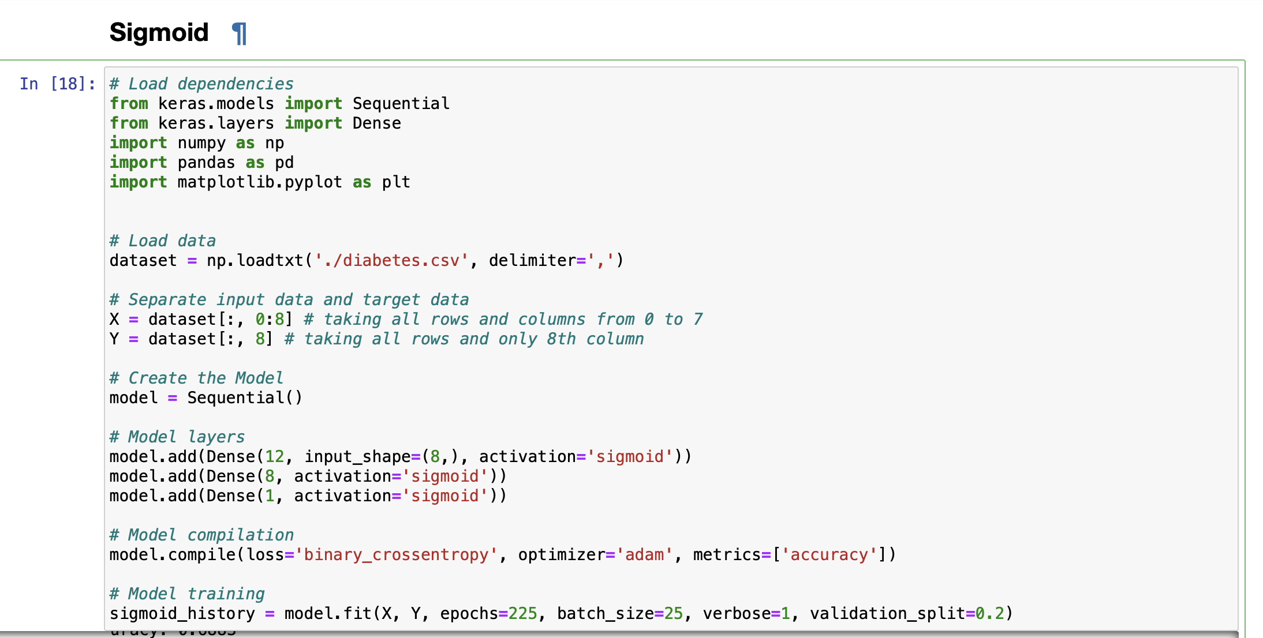
Implementation - sigmoid
Sigmoid:
.
g

Slide 14
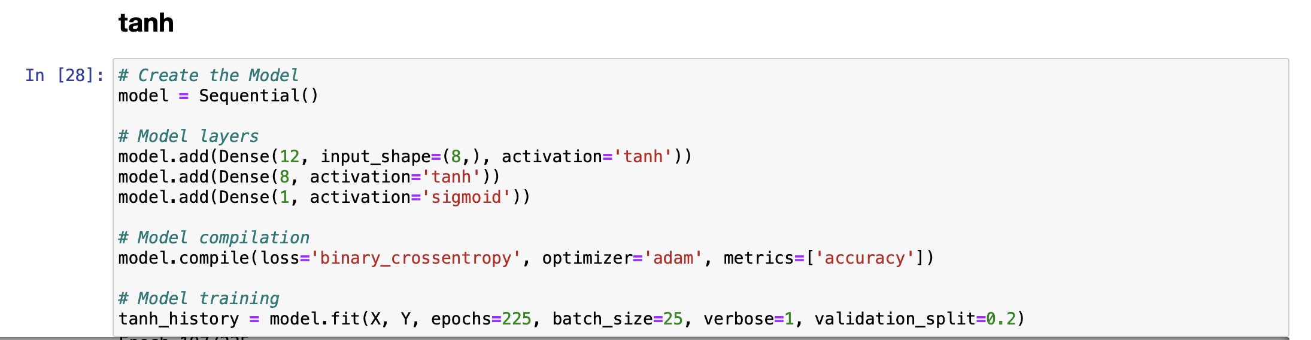
Implementation - tanh
tanh:

Slide 15
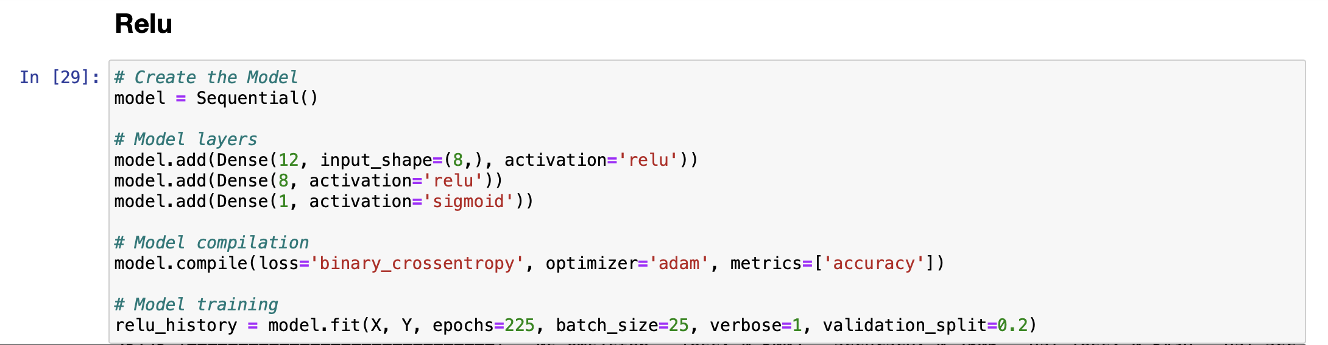
Implementation - Relu
Relu:

Slide 16
Comparisons
For Relu:
For tanh:
For Sigmoid

Slide 17
Conclusion:
Activation function must be continues, differentiable and easy to differentiate
Sigmoid – Mainly used in output layers
- values range (0,1)
- These values interpreted as a probability belonging to a class
- eg : to predict whether a mail is spam or not
tanh - used in hidden layers
- values range (-1,1)
- This allows negative weights in the model
- ex : it can be used in time-series prediction problem, when negative weights can help to capture certain temporal relationship in the data
Relu – Commonly used in hidden layers
- Computationally efficient and no problem of vanishing and exploiding gradient
- Not sensitive to outliers in the data

